Slide 2
" In The Name of Allah, The Most Beneficent, The Most Merciful" Food safety in Halal/religious food and non-food products By: Dr. Hani M. Al-Mazeedi

Slide 3
Is religious products are safe to use or to eat?
هل المنتجات الدينية آمنة للإستعمال أو الإستهلاك؟

Slide 4
Opening speech
Religious guidance are the landmarks in ensuring safety
التوجيه الديني هي المعالم في ضمان السلامة

Slide 5
Scope

Slide 6
This presentation aims to prove that there is a link between safety aspects in Halal/religious food and non-food products and religious guidance sourced from scriptures to ensure: the safety of ingredients¹, the methods of processing², and the health of consumers³.

Slide 7
Our methodology in this presentation is to quote texts from:
The scriptures (the Torah, the Bible), and the Quran as the sources of religious guidance in ensuring the safety of food and non-food products, from
The Hadith of the prophet Mohammed peace be upon him, and from
Some of the testimonies of non-Muslims with regard to the safety of religious products and religious methods of processing.
Hadith: what is one of various reports describing the words, actions, or habits of the prophet Mohammed PBUH.

Slide 8
Why is this subject?

Slide 9
The main reason why this topic is being presented because there are individuals who believe that scriptures doctrine have nothing to do with the safety of food and non-food products such as “Halal” and “Kosher” products.

Slide 10
This belief is becoming universal and spreading globally.
Especially in this era, in which the origins of ingredients in products and methods of productions are diversified and from mix countries of different scriptural and non scriptural cultures i.e. from non-divine beliefs.

Slide 11
Content

Slide 12
Scope
Why is this subject?
Introduction
Requirements of Scriptures in food
Terminologies related to Halal
What products and services we should be concern with?
Comparisons between present and past with regard to safety in religious food
Suspected adverse health effects in non religious ingredients or processes
Critical components of religious nature in food and non-food products
Challenges facing halal
The Halal concept
Recommendations
References

Slide 13
Introduction

Slide 14
Food safety may be monitored and controlled by applying different food safety standards and guidelines generally extracted from scriptures and Sunnah, such as:
Good Manufacturing Practices (GMP)
Hazard Analysis & Critical Control Points (HACCP: ISO 22000)
FSSC 22000 Food Safety System Certification
British Retail Consortium (BRC)
Global Food Safety Initiative (GFSI)
International Standards (ISO)
Codex Alimentarius International guidelines on food safety, &
by using organic ingredients

Slide 15
Requirements of Scriptures in food

Slide 16
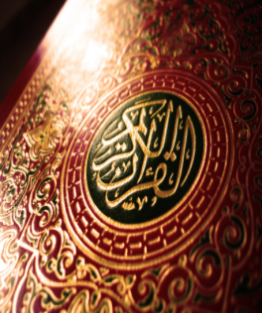
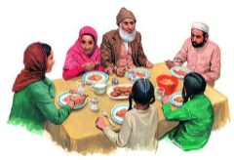
Scriptures requirements on food are well expressed by prominent divine religions:
Islam
Christianity
These religions put great emphases:
¹to follow specific way when slaughter of sacrificial animals,
² to follow humane methods in obtaining food from animals and birds
³not to eat pork, or dead meat
⁴not to eat blood, and
⁵to some extent, in Judaism and Christianity religions, to minimize drinking of intoxicants, however, in Islam to Avoid and Not to Approach intoxicants.
Judaism

Slide 17
The translation of the meaning of the Quran 2:172
O you who have believed, eat from the good things which We have provided for you and be grateful to Allah if it is [indeed] Him that you worship.
Good things = Safe things, that are of good quality

Slide 18
The translation of the meaning of the Quran 5:3
Prohibited to you are dead animals¹, blood², the flesh of swine³, and that which has been dedicated to other than Allah⁴, and [those animals] killed by strangling⁵ or by a violent blow⁶ or by a head-long fall⁷ or by the goring of horns⁸, and those from which a wild animal has eaten⁹, except what you [are able to] slaughter [before its death].

Slide 19
The translation of the meaning of the Hadith
Abu Ya’la Shaddad ibn Aus, radiyallahu ‘anhu, reported that the Messenger of Allah, sallallahu ‘alayhi wasallam, said:
“Verily, Allah has prescribed welfare with regard to everything. So, when you kill, kill in a good way¹; when you slaughter, slaughter in a good way²; so everyone of you should sharpen his knife³, and let the slaughtered animal die comfortably⁴.”

Slide 20
The translation of the meaning of the Quran 5:90-91
O you who have believed, indeed, intoxicants, gambling, [sacrificing on] stone alters [to other than Allah ], and divining arrows are but defilement from the work of Satan, so avoid it that you may be successful.
Satan only wants to cause between you animosity and hatred through intoxicants and gambling and to avert you from the remembrance of Allah and from prayer. So will you not desist?
Intoxicants = wine, beer, whiskey, any drink that contain alcohol to intoxicant levels.

Slide 21
Terminologies related to Halal

Slide 22
The word Halal in Islam means it is permissible and the legislature, the almighty God, has authorized it.
The word Tayyib mean good and safe, that it is without harm and malice.
The words Halal and Tayyib come together in the Holy Quran.
Tayyib = Good things = Safe things, that are of good quality

Slide 23
Halal is the knowledge and action taken to avoid
hazards in what we eat and what we consume in its four categories
i.e. Microbial, chemical, physical,
In addition, to that of religious nature
In products and services
in this era
were there are many emerging cases
and varied sources
of raw ingredients and methods of production

Slide 24
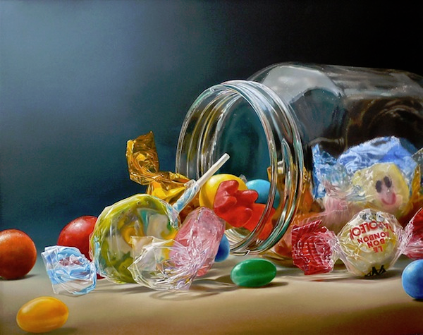
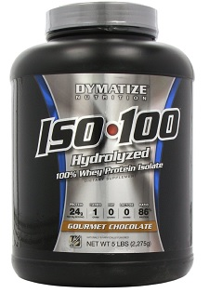
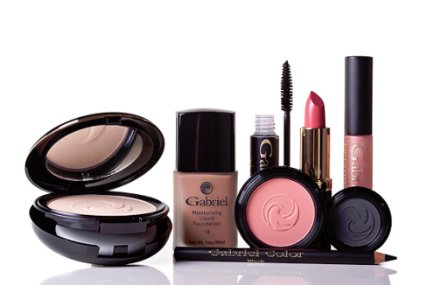
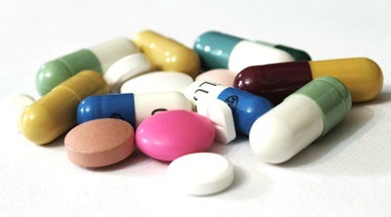
Halal is the subject that every single Muslim should be acquainted with in food, non-food products and services to avoid Hazardous components¹ and non-safe methods² of production.

Slide 25
What products and services we should be concern with?

Slide 26
Halal covers both food and non-food products and services
1. Food and beverage products.
2. Cosmetics.
3. Pharmaceuticals.
4. Health Care Products.
5. Personal and household cleaning items.
6. Supportive services (analytical laboratories, Halal certification, etc.).
7. Primary raw materials (e.g. gelatin, enzymes, fats, proteins).

Slide 27
Comparisons between present and past with regard to safety in religious food

Slide 28
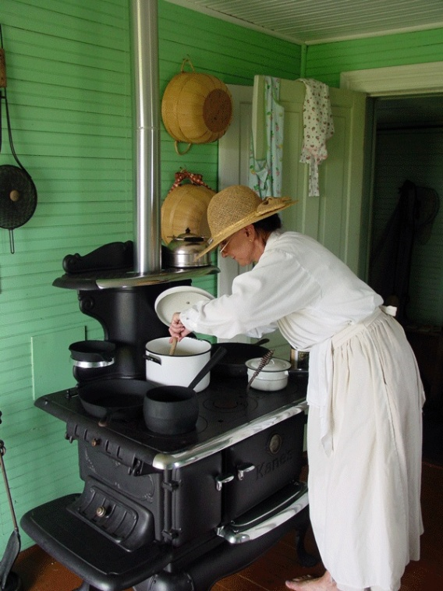
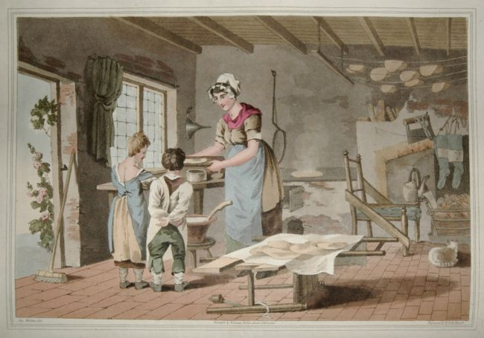
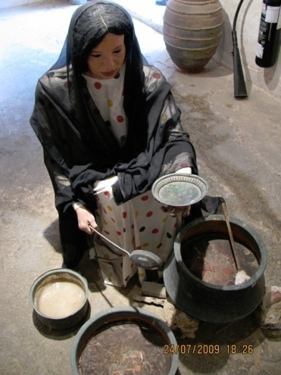
In the past
People knew from where their food came from and how it was produced or manufactured.
In the early days, Muslim scholars were not preoccupied with issues related to Halal and Tayyib in their food and non-food products, to the extent in which Muslim scholars now a day.

Slide 29
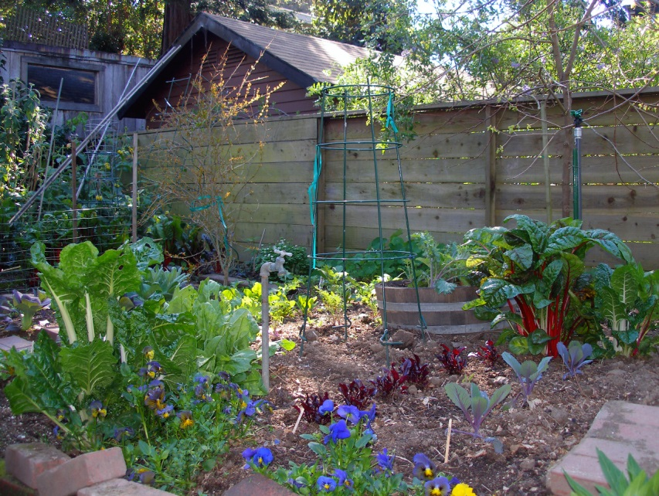
Their farms were in their homes and in the countryside they owned,
Both were organic and simple.
And they do not use foreign or chemical substances in agriculture.

Slide 30
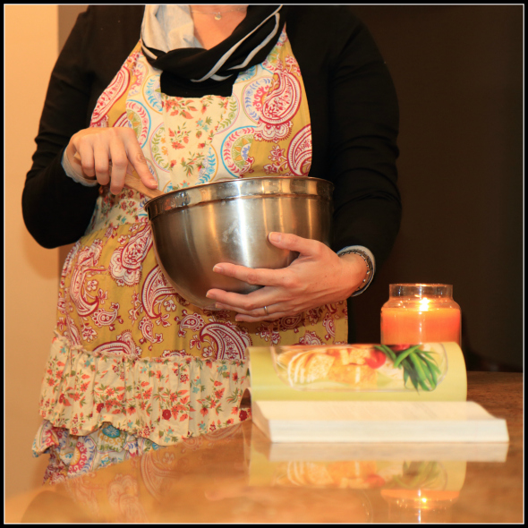
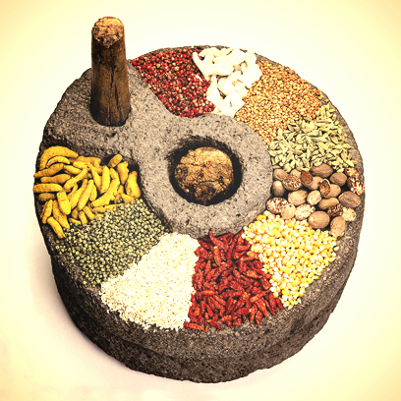
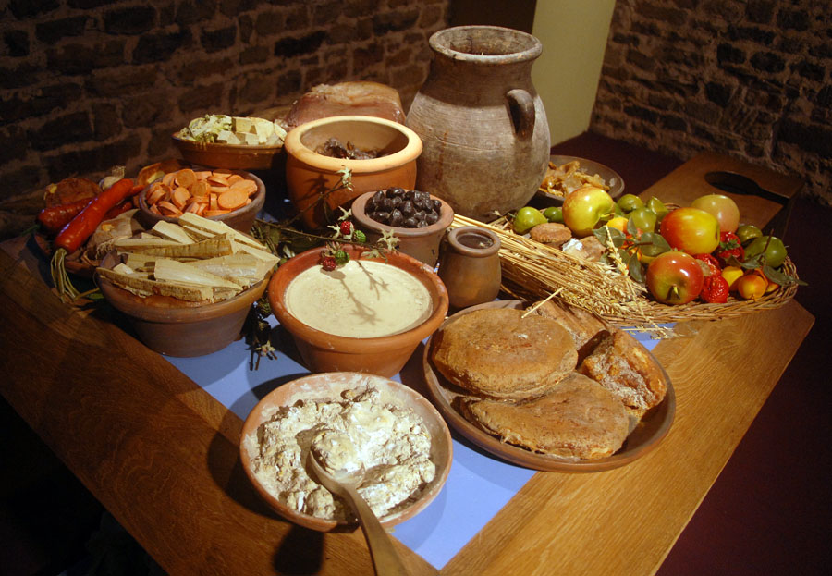
In the past they used to prepare their meals at home

Slide 31
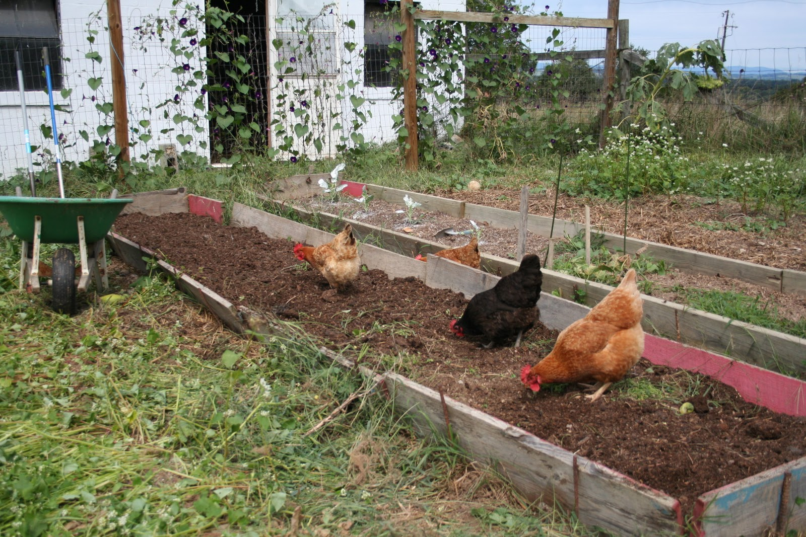
Feed were 100% from plant sources

Slide 32
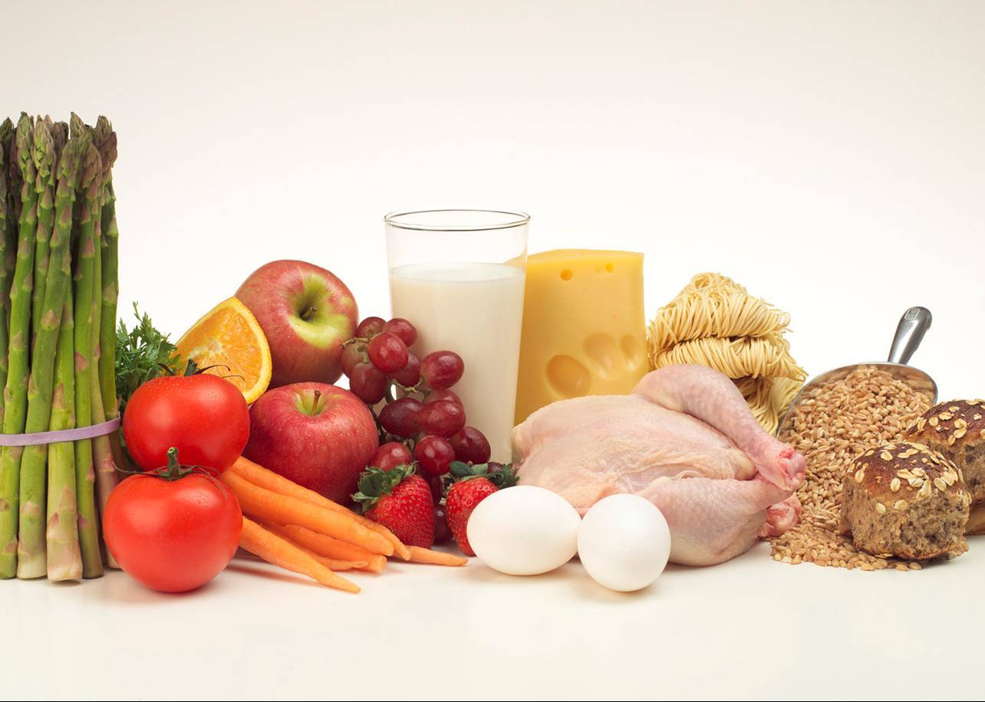
However, after the transfer of man from life in the countryside to the cities this has resulted in:
تقدم في تكنولوجيا الغذاء

Slide 33
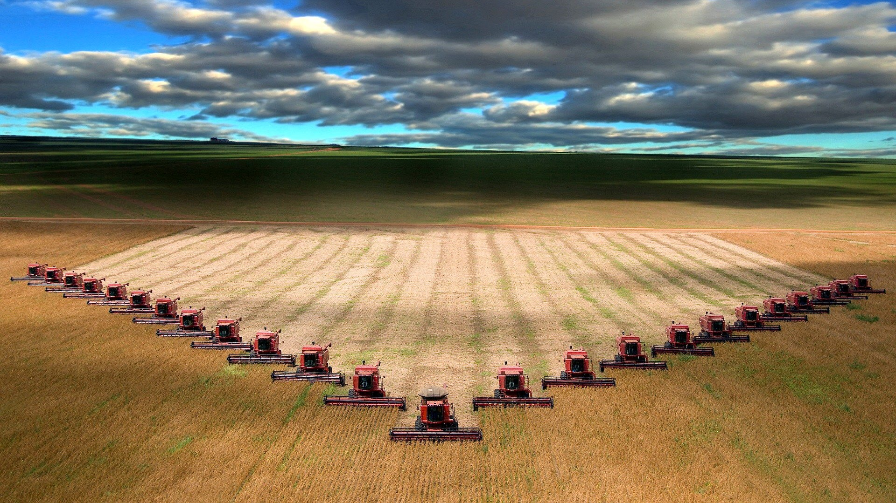
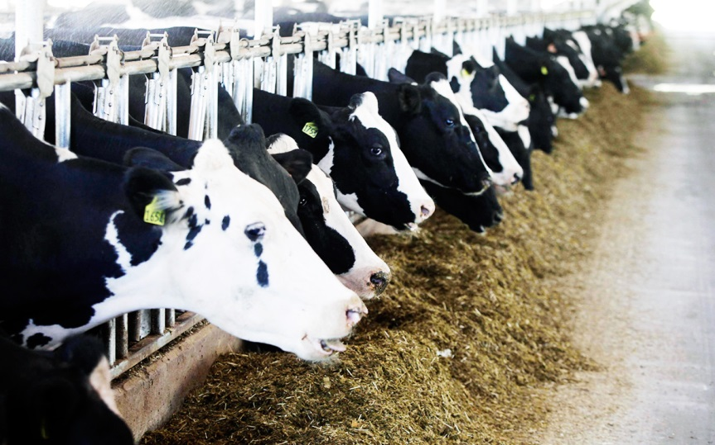
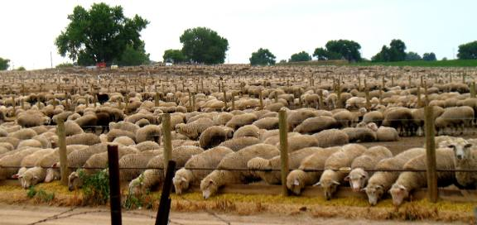
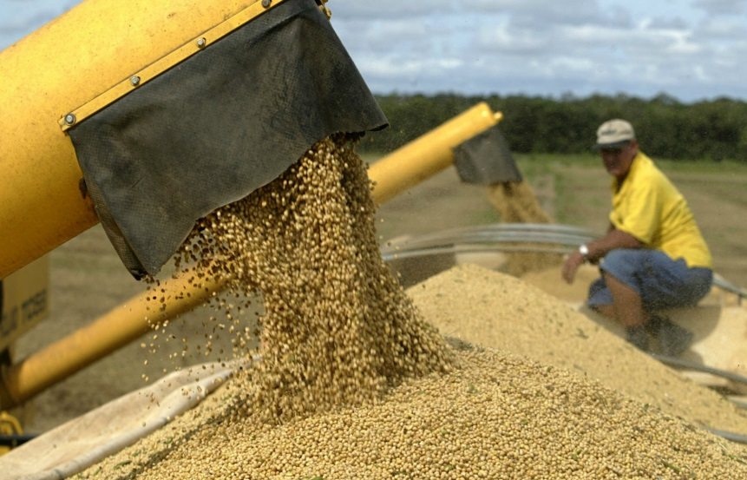
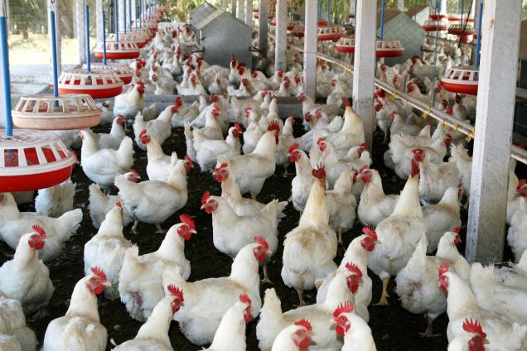
Increase in population
And intensity in agricultural production
There was a need for an increase in
Beef and dairy cattle production
Sheep production
Wheat production
Poultry production and

Slide 34
And as a result of civil life style
and the leaving out of rural life
An advancement in food technology was brought about

Slide 35
And the beginning of the change of our food such as:
The genetic change of food
The production change of food
The processing change of food
The ingredients change of food
The preparation change of food
The eating habits change of food

Slide 36
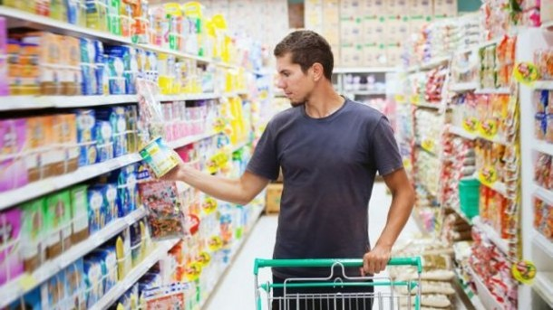
And the emergence of big companies
that became a part of our daily lives

Slide 37
So what are the suspected adverse health effects in non religious ingredients or processes?

Slide 38
These are the main things we are concerned with:
Pork
Alcohol
Processes
Blood
Dead meat

Slide 39
Pork
Scriptures tells us not to eat pork. This has to do with any thing that comes from a pig, the hog, the swine.
People who eat pork chops, ham, bacon for their health sake have to be welling to make some changes. God knows what best for His creatures.
In the scriptures, the pig was prohibited, and it was never considered as a source of food. One of the reason why is may be because the pig was considered unclean and would eat any thing.

Slide 40
A pig eat waste, garbage, and eat his own dead child. A pig eat other sick and infected animals, they are scavengers.
What's interesting the pig has one of the quickest and poorest digestive system of any animals that it takes only four hours to complete the digestion and that’s not good.
Because the digestive system is so quick and so poor many times the toxins from the food are not properly eliminated and they are stored in the pig’s fat.

Slide 41
That mean that pig can eat all kind of filth and garbage and eat other infections and four hours later it sent to the slaughter and butcher and in a few days it is only a plate at the home of those who eats pig’s meat.
The toxin is not properly eliminated from the pig.

Slide 42
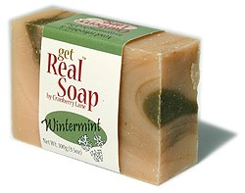
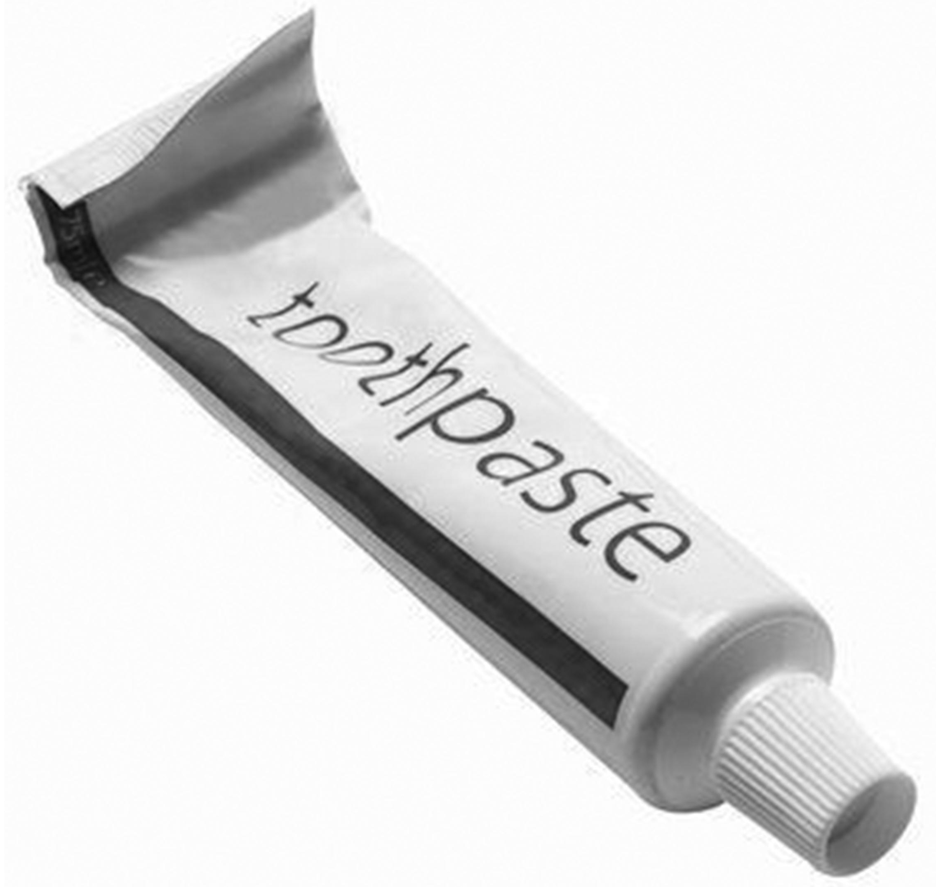
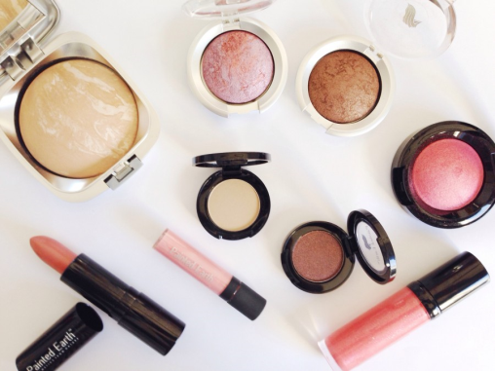
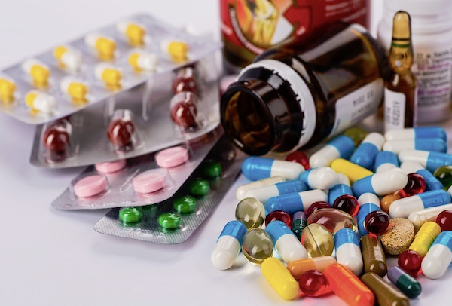
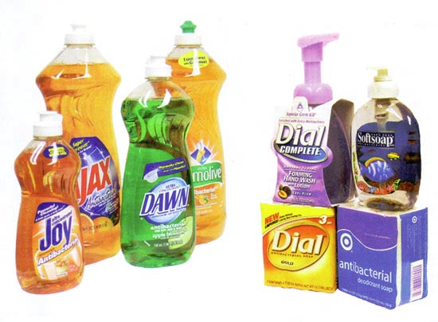
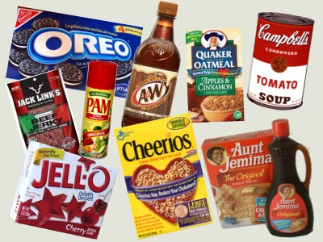
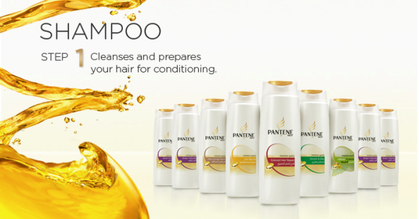
There is a misunderstanding here
that needs to be clarified
Halal is no longer only for meat but also for products and services

Slide 43
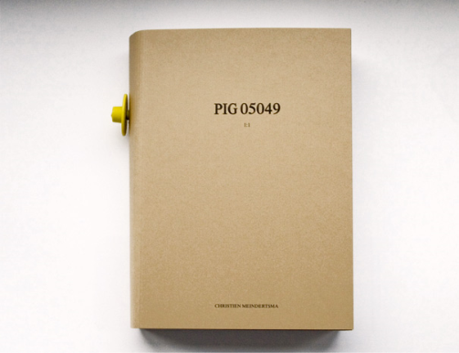
Many food products that we may use on a daily basis in our contemporary world are manufactured from by-products of a pig.
What's proven that
Is the book of Christien Meindertsma from the Netherlands entitled:
Pig 05049
* http://www.christienmeindertsma.com/index.php?/books/pig-05049/

Slide 44
Christine discovered after three years of research on products made of pig parts that there is:
185
Different products that are manufactured from pig by products.

Slide 45
Some of Christine’s unexpected search on pig’s by products that enters manufactured products are the following:
Some types of: bullets, drugs, photographic photocopy papers, heart valves, brakes, chewing gum, porcelain, cosmetics, cigarettes, hair smoothing, antiperspirant deodorant, and even biodiesel was not spared from the pig.

Slide 46
Christine said: If you are a Muslim or Vegans you still consume many products made ​​from pork, which include the following parts:
skin, bones
2. flesh and internal organs <
3. blood, fat, and other parts of pig

Slide 47
Christine then divided pig’s parts into sections based on their uses, and this is what she got:

Slide 48
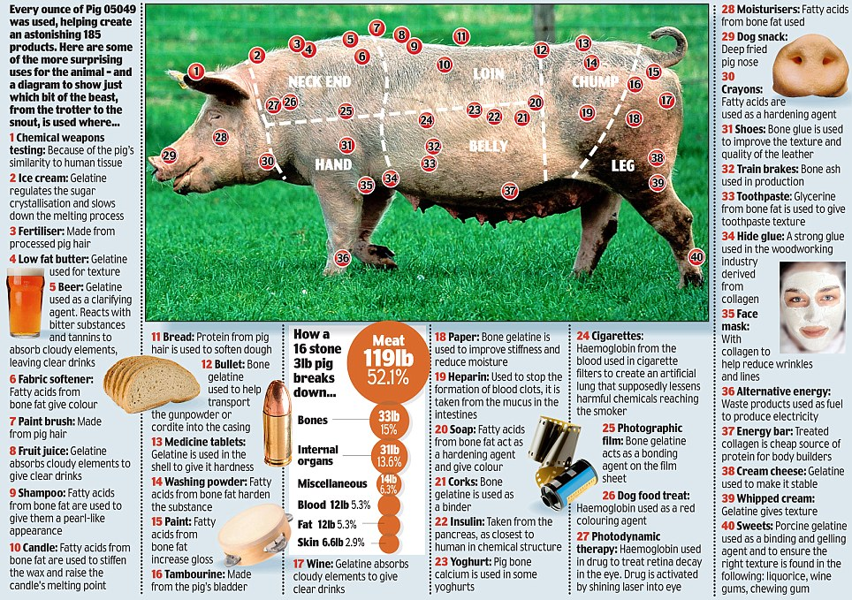

Slide 49
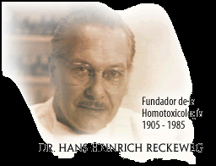
Professor Hans in his biological therapy has based his observations on the Germans before and after the consumption of pork products, and this is what he found:
Eating pork may causes tension, stress, fatigue and toxicity
Hans-Heinrich Reckeweg, 1983. The Adverse Influence of Pork Consumption on Health. Biological Therapy Vol.1 No. 2 1983 http://www.firstchurchoftheinternet.org/studies/eatingpork.htm

Slide 50
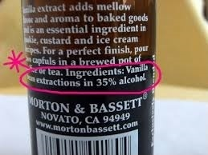
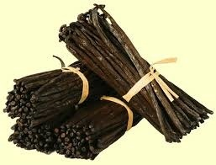
Alcohol
Alcohol is used in the production of food and non-food components such as:
Vanilla: where alcohol is used to extract vanilla falvour from the vanilla beans and in the West, by law vanilla contains 35 to 50% alcohol.
Food flavors.
Food colors

Slide 51
Now, if you bake gooey brownies and like them super soft in the middle, we can't guarantee that 100% of the alcohol in the vanilla is evaporated out of your goods.
And of course if you use vanilla (or any extract) in a cold item such as Vanilla ice-cream, the alcohol will remain.
https://lagrima.com/blogs/news/10179737-is-there-alcohol-left-after-i-bake-with-vanilla-extract

Slide 52
Although alcohol affects every member of the body, its effect is most on the liver.
2) Alcohol causes impaired liver capacity to metabolize fats and thus accumulate fat in the liver and damage it by cirrhosis.
3) Alcohol intake increases the risk of arthritis.
4) Alcohol intake increases blood pressure, blood lipids, risk of stroke, and heart disease, especially with addicts.
5) Intake of alcohol may raise the level of sugar in the blood.
6) Alcohol causes depression, anxiety and insomnia.

Slide 53
Interesting personal explanation on why would Judaism and Christianity current scriptures allow the drinking of a little amount of alcohol and permitted to the extent that it does not lead to lost of mind/conscious.

Slide 54
In Islam, Alcohol is not allowed to be drank at all at any amount, however, some juices may naturally develop minute amounts of alcohol trapped inside the bulb of the juice as a natural preservative i.e. not liberated into the juice.

Slide 55
In Islam such juices are not allowed to be drank if Alcohol is liberated from the bulb to its juice and reaches a % that caused lost of mind, a sign of that is the production of Co₂ gas (i.e. bubbling juice).

Slide 56
So this may be was the case in the original scriptures of Judaism and Christianity that alcohol originally was not allowed at any amount and forbidden and with time those scriptures were fabricated to allow the drinking of the actual wine containing Alcohol but at a small amount.

Slide 57
Alcohol in finished food
A study by a team of researchers at the University of Idaho, Washington State University, and the US Department of Agriculture's Nutrient Data Laboratory calculated the percentage of alcohol remaining in a dish based on various cooking methods. The results are as follows:

Slide 58
alcohol added to boiling liquid and removed from heat: 85% alcohol retained
alcohol flamed: 75% alcohol retained
no heat, stored overnight: 70% alcohol retained
baked, 25 minutes, alcohol not stirred into mixture: 45% alcohol retained
baked/simmered, alcohol stirred into mixture: (see table)

Slide 59
Time (h) | Alcohol retained
0.25 | 40%
0.57 | 35%
1.1 | 25%
1.6 | 20%
2.0 | 10%
2.6 | 5.0%
https://en.wikipedia.org/wiki/Cooking_with_alcohol
https://www.nal.usda.gov/sites/default/files/fnic_uploads/Alcohol-Retention.pdf

Slide 60
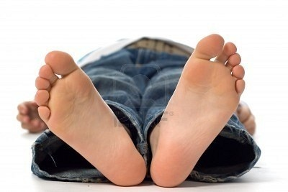
Processes
How are the birds and animals processed before slaughtering?
The law in Europe requires that all animals and birds must undergo pre-slaughtering methods (i.e. stunned) to render them, as they claimed, unconscious or dead before they bleed*.
Lately, there is a call from HAS** for an effective stunning, i.e. complete death of birds before slaughter, i.e. stun-to-kill.
*V. Sante, G. Le Pottier, T. Astruc, M. Mouchonie`re, and X. Fernandez (2000). Effect of Stunning Current Frequency on Carcass Downgrading and Meat Quality of Turkey. Poultry Science 79:1208–1214.
**HAS = Human Slaughter Association (has.org.uk)

Slide 61
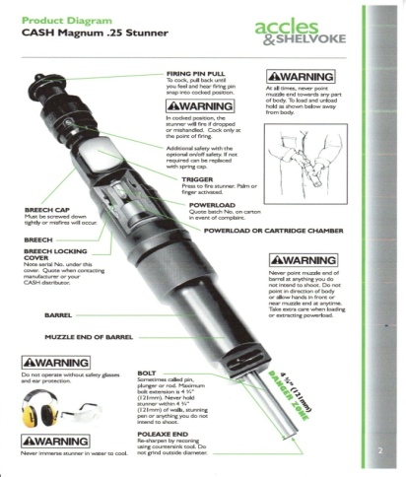
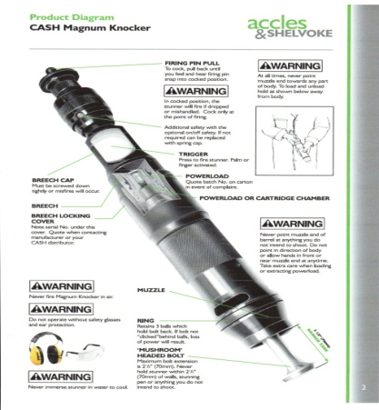
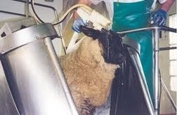
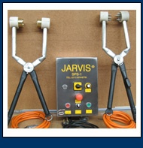
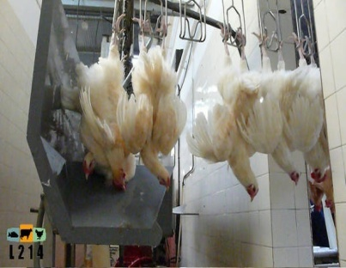
Examples of pre-slaughtering methods (or stunning methods)
Captive-bolt shot into the brain
Mushroom gun shot into the head*
Electric stunning using a water-bath
Electric shock
Controlled atmosphere Killing (CAK) using gas mixtures.
*Percussion stunning ,or air gun stunning

Slide 62
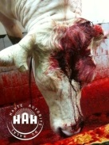
All of these methods can have: adverse health effects¹ and downgrade meat quality². *
Stunning methods causes visual effects such as bruising¹ and hemorrhages (blood splash)², and bruising³, pelt burn in sheep⁴, bone fractures⁵, color changes caused by Dark Firm and Dry meat, DFD⁶ as well as those manifested in eating quality such as toughness.
* Effects of slaughter method on carcass and meat characteristics in the meat of cattle and sheep, Dr M.Haluk ANIL, http://www.eblex.org.uk/wp/wp-content/uploads/2013/04/slaughter_and_meat_quality_feb_2012-final-report.pdf
** Private conversations

Slide 63
Bruising in cattle may occur during heavy falls after stunning.
During electrical stunning blood pressure changes, and convulsions can cause ruptures and hemorrhages where blood leak out of: vessels¹ and small veins² into the muscle.
* Effects of slaughter method on carcass and meat characteristics in the meat of cattle and sheep, Dr M.Haluk ANIL, http://www.eblex.org.uk/wp/wp-content/uploads/2013/04/slaughter_and_meat_quality_feb_2012-final-report.pdf
** Private conversations

Slide 64
stunning methods may also have effects on animal welfare (i.e. causes pain to the live animal/birds) ¹ , as well as on public health² especially as a result of the BSE threat this was based on studies using experimental contamination with marker bacteria.
Stunning methods may ultimately lead to animal death within a period of time that varies between one animal to another animal from minutes - days. **
* Effects of slaughter method on carcass and meat characteristics in the meat of cattle and sheep, Dr M.Haluk ANIL, http://www.eblex.org.uk/wp/wp-content/uploads/2013/04/slaughter_and_meat_quality_feb_2012-final-report.pdf
** Private conversations

Slide 65
At higher stunning frequencies (1500Hz) chickens will recover back to clear signs of life that is breathing and moving after 16 seconds and 57 seconds respectively after stunning*.
The question here: Is the living status of the stunned bird or animals at high frequencies at the time of slaughter i.e. not breathing or not in a motional state will meet the demands of religious slaughter?
*Gregory, N. G., L. J. Wilkins, and S. B. Wotton, (1991). Effect of electrical stunning frequency on ventricular fibrillation, downgrading and broken bones in broilers, hens and quails. Br. Vet. J. 147:71–77.

Slide 66
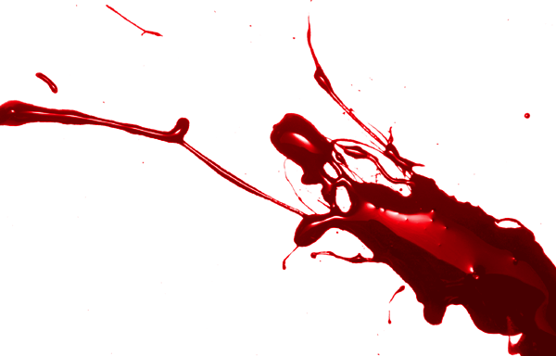
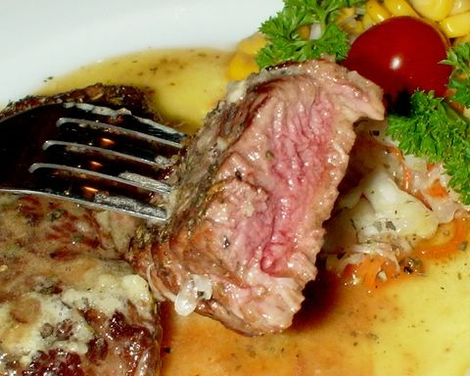
Blood
Because blood is the best environment for the growth of bacteria and microbes, and contains a high percentage of toxic carbon dioxide, and uric acid.
And because the heat of cooking used does not enter all the cooked meat particles.
Then still part of the poorly cooked meat at risk from pathogenic bacteria that may still exist due to its initial present in the blood after slaughtering stunned animal.
http://able2know.org/topic/202098-1

Slide 67
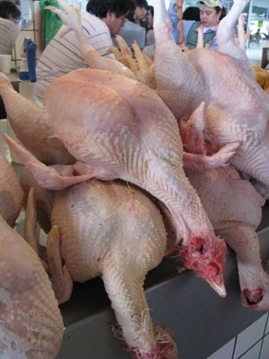
Dead meat
There are other health risks with stunned meat that is the eating of dead meat, i.e. slaughtering will be of no value with dead animal.
So, what is the adverse health effect when eating dead meat?
When sacrificial animal die, bacteria will transmit across the gut very quickly, so there is a need to slaughter the animal when they are fully alive and eviscerate نزع الأحشاء quickly to prevent infections.
http://www.backyardchickens.com/t/697920/dead-meat-bird-okay-to-eat

Slide 68
Sheikh Prof. Nasser bin Abdullah Al Maiman has said*
On the basis of what have been said on the use of stunning
It is better not to resort to any method of loss of consciousness; we should close the door of its discussion once and for all; as if we opened it both lawful safe and unlawful unsafe things will be entered.
* Professor of Higher Islamic Studies, Umm Al-Qura University, Makkah, and a member of the Shura Council, Saudi Arabia

Slide 69
What are the critical components of religious nature that must be avoided in food and non-food products?

Slide 70
Alcohol
Najis materials (dead, insects, urine substances)
Ingredients of animal origin such as:
Animal tissues (Flesh, bone, skin)
Plasma (blood)
Gelatin
Fat
Glycerin
Fatty acids
Amino acids
Enzymes (Rennet in cheese, media used in microbial cultures)
Composition of DNA (nucleotide)

Slide 71
The Halal concept

Slide 72
The Halal concept may be looked at as a reference guideline to control safety¹ and quality² of consumable materials from production to consumption.
Consumable materials could range from food¹, beverages², cosmetics³, medicine⁴ and personal care products⁵ for human to feed for animals.

Slide 73
Halal is more than just a label? It is a guarantee of quality, safety and cleanliness for everyone

Slide 74
Halal is for everyone not just for Muslim Consumers, but for any Consumer who is looking for Integrity¹, Quality², and Purity³ in their lifestyle products.

Slide 75
Recommendations

Slide 76
we should encourage companies to compete on providing Halal/religious products.
Muslim consumers should be educated on Halal terminologies and their applications in their life.
Muslim consumers should not rely in Halal totally on their governmental control agencies, they must depend on themselves questioning before they buy.
Muslim scholars in any geographical region for the sake guidance of their Muslim followers should unite on strong evidences on one opinion with regard to Halal and Haram.

Slide 77
References

Slide 78
V. Sante, G. Le Pottier, T. Astruc, M. Mouchonie`re, and X. Fernandez) 2000(. Effect of Stunning Current Frequency on Carcass Downgrading and Meat Quality of Turkey. Poultry Science 79:1208–1214.
Rizwan Khalid of Bristol University.
Gregory N.G. & Wotton S.B. (1990). Effect of stunning on spontaneous physical activity and evoked activity in the brain. British Poultry Science. 31: 215-220.
Gregory, N. G., and S. B. Wotton (1987). Effect of electrical stunning on the electroencephalogram in chickens. Br. Vet. J.: 143, 175-183.
S. Prinz, G. Van Oijen, F. Ehinger, A. Coenen and W. Bessei (2010). Electroencephalograms and physical reflexes of broilers after electrical waterbath stunning using an alternating current. Poult Sci. 89:1265-1274.
Kettlewell, P.J. and Hallworth R.N. (1990). Review paper, Electrical stunning of chickens. J. agric. Engng Res. 47, 139-151.
M. Mouchoniere` RE, G. Le Pottier, and X. Fernandez (1999). The Effect of Current Frequency During Waterbath Stunning on the Physical Recovery and Rate and Extent of Bleed Out in Turkeys. Poultry Science 77:485–489.
Regulations: Council regulations (EC) No 1099/2009 of 24 September 2009 on the protection of animals at the time of killing. Official Journal of the European Union. http://eur-lex.europa.eu/JOHtml.do?uri=OJ:L:2011:040:SOM:EN:HTML
Gregory, N. G., L. J. Wilkins, and S. B. Wotton, (1991). Effect of electrical stunning frequency on ventricular fibrillation, downgrading and broken bones in broilers, hens and quails. Br. Vet. J. 147:71–77.
Sayda A. M. Ali, Hyder O. Abdalla, and Ibrahim M. Mahgoub: Effect of slaughtering methods on the keeping quality of broilers chickens meat (email: saydamhmmd@yahoo.com)
Zabh Halal VS. Stunning Method, By: Dr Jawad Hidmi (PhD)
http://azkahalal.files.wordpress.com/2013/02/arabic_version_of_halal_culture_presentation_2013.pdf
http://azkahalal.files.wordpress.com/2012/06/gimdes-2012_dr-hani-al-mazeedi1.pdf
http://www.asidcom.org/IMG/pdf/L20-_Hani_M-_Al-Mazeedi_Arabic_English_2.pdf
http://www.asidcom.org/IMG/pdf/L1-_Darhim_Dali_Hashsim.pdf
http://www.asidcom.org/IMG/pdf/L26-_Dr-_Irfan_Sungkar.pdf
http://azkahalal.files.wordpress.com/2014/05/kisr-halal-2014-mariam-abdulatif.pdf
https://en.wikipedia.org/wiki/Cooking_with_alcohol
https://www.nal.usda.gov/sites/default/files/fnic_uploads/Alcohol-Retention.pdf
Effects of slaughter method on carcass and meat characteristics in the meat of cattle and sheep, Dr M.Haluk ANIL, http://www.eblex.org.uk/wp/wp-content/uploads/2013/04/slaughter_and_meat_quality_feb_2012-final-report.pdf
Private conversations
https://lagrima.com/blogs/news/10179737-is-there-alcohol-left-after-i-bake-with-vanilla-extract
البخاري : الشركة (2488) , ومسلم : الأضاحي (1968), والترمذي: الأحكام والفوائد (1491), والنسائي: الضحايا (4410), وأبو داود: الضحايا (2821), وأحمد (3/463.(
الموسوعة الفقهية، الجزء التاسع والثلاثون، ص 324، وزارة الأوقاف والشئون الإسلامية، دولة الكويت.

Slide 79
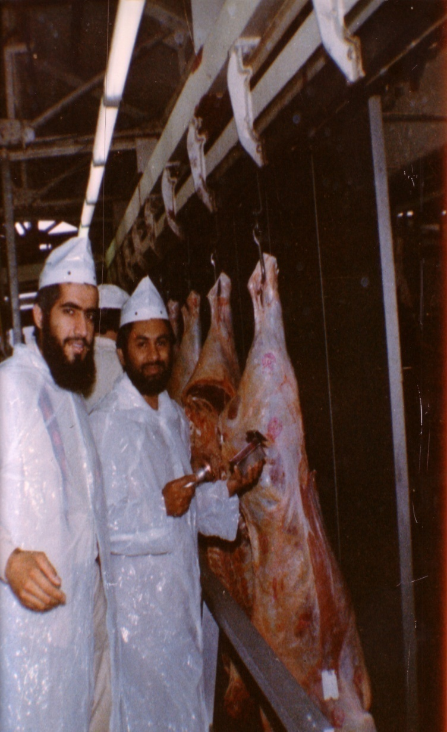
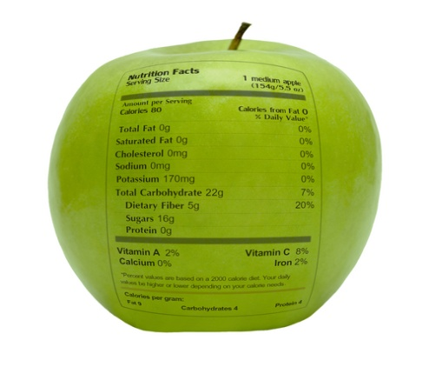
Thank You for your kind attention
سبحنك اللهم وبحمدك أشهد أن لا إله إلا أنت، أستغفرك وأتوب إليك
د. هاني منصور المزيدي
مع الأخ أمجد محبوب في أستراليا سنة 1981
Dr. Hani Mansour Al-Mazeedi
With brother Amjad Mahboob in Australia in 1981

Slide 80
www.HalalEA.com
Trademarks, icons, images belong to their respective owners.
© Halal Sciences Academy Limited

